Slide 1


Network Models
SOCIAL
MEDIA
MINING

Slide 2
Dear instructors/users of these slides: Please feel free to include these slides in your own material, or modify them as you see fit. If you decide to incorporate these slides into your presentations, please include the following note:
R. Zafarani, M. A. Abbasi, and H. Liu, Social Media Mining: An Introduction, Cambridge University Press, 2014.
Free book and slides at http://socialmediamining.info/
or include a link to the website: http://socialmediamining.info/

Slide 3
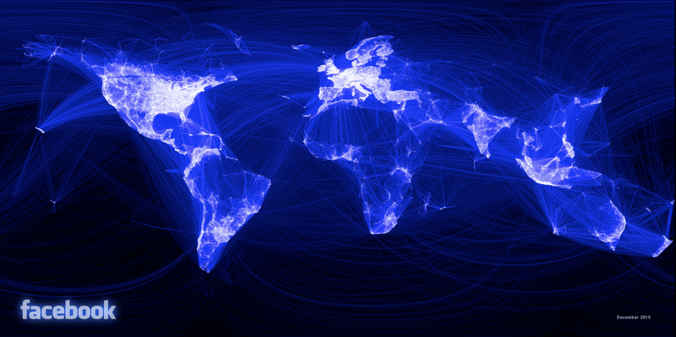
Why should I use network models?
Facebook
May 2011:
721 millions users.
Average number of friends: 190
A total of 68.5 billion friendships
September 2015:
1.35 Billion users
What are the principal underlying processes that help initiate these friendships?
How can these seemingly independent friendships form this complex friendship network?
In social media there are many networks with millions of nodes and billions of edges.
They are complex and it is difficult to analyze them

Slide 4
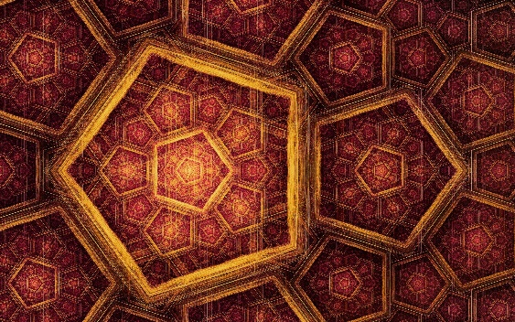
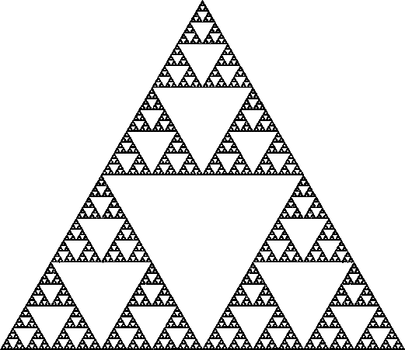

So, what do we do?
Design models that generate graphs
The generated graphs should be similar to real-world networks.
If we can guarantee that generated graphs are similar to real-world networks:
We can analyze simulated graphs instead of real-networks (cost-efficient)
We can better understand real-world networks by providing concrete mathematical explanations; and
We can perform controlled experiments on synthetic networks when real-world networks are unavailable.
What are properties of real-world networks that should be accurately modeled?
Basic Intuition:
Hopefully! Our complex output [social network] is generated by a simple process

Slide 5
Properties of Real-World Networks
Power-law Distribution
High Clustering Coefficient
Small Average Path Length

Slide 6
Degree Distribution

Slide 7
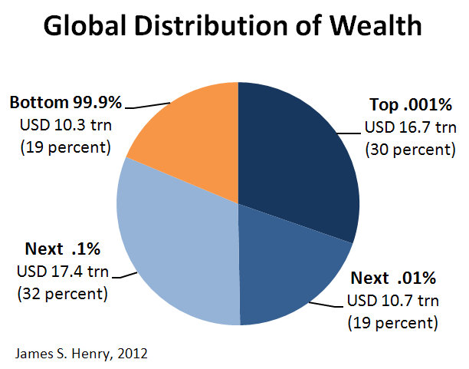
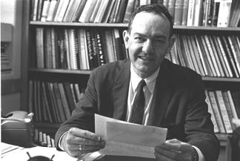
Distributions
Wealth Distribution:
Most individuals have average capitals,
Few are considered wealthy.
Exponentially more individuals with average capital than the wealthier ones.
City Population:
A few metropolitan areas are densely populated
Most cities have an average population size.
Social Media:
We observe the same phenomenon regularly when measuring popularity or interestingness for entities.
Herbert A Simon,
On a Class of Skew Distribution Functions, 1955
The Pareto principle
(80–20 rule): 80% of the effects come from 20% of the causes

Slide 8
Distributions
Site Popularity:
Many sites are visited less than a 1,000 times a month
A few are visited more than a million times daily
User Activity:
Social media users are often active on a few sites
Some individuals are active on hundreds of sites
Product Price:
There are exponentially more modestly priced products for sale compared to expensive ones.
Friendships:
Many individuals with a few friends and a handful of users with thousands of friends
(Degree Distribution)

Slide 9
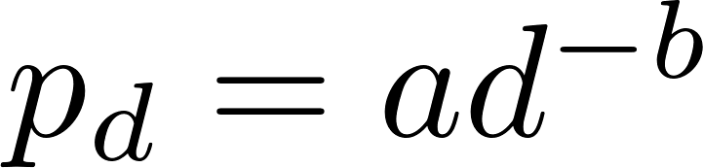
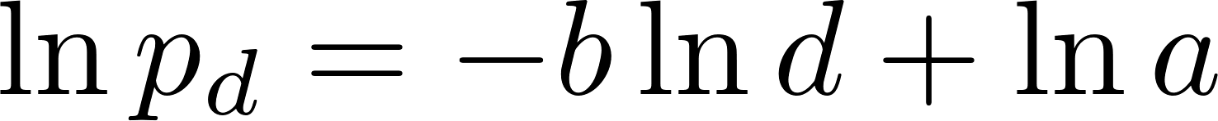
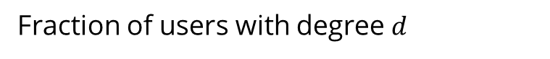
Power-Law Degree Distribution
When the frequency of an event changes as a power of an attribute
The frequency follows a power-law
The power-law exponent and its value is typically in the range of [2, 3]
Power-law intercept
Fraction of users with degree $d$
Node degree

Slide 10
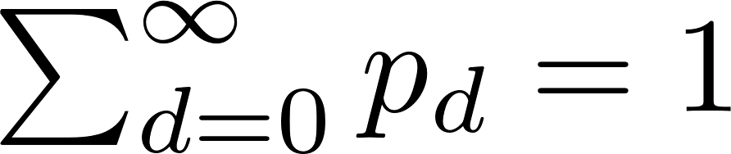
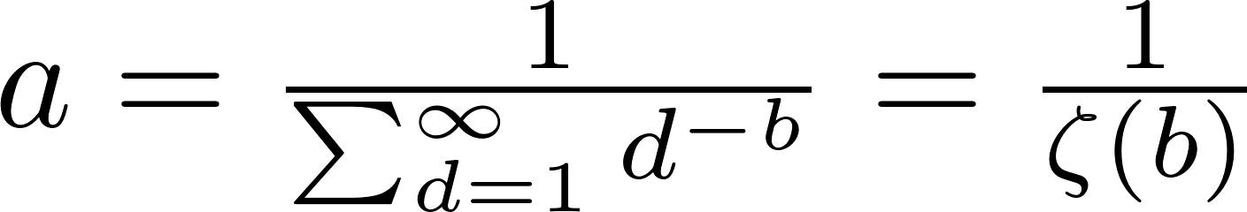
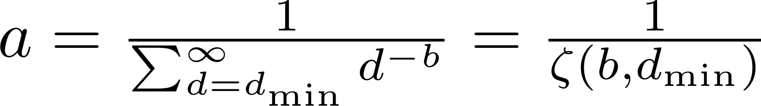


Some Properties of Power-Laws
We have
So,
Usually the very first $d$ values do not exhibit power-law distribution
$p_{0}$ has to be zero!
Riemann Zeta Function
Can be numerically
approximated
Generalized (incomplete) Zeta Function

Slide 11
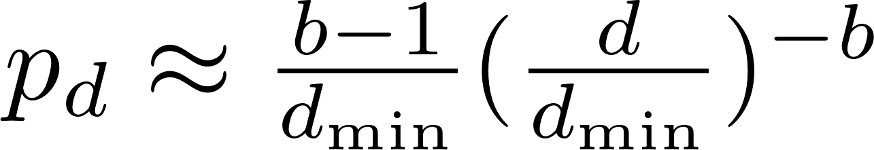
Approximating $a$
We can approximate by integrating
Then,

Slide 12
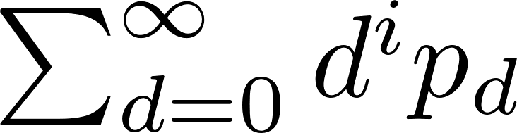
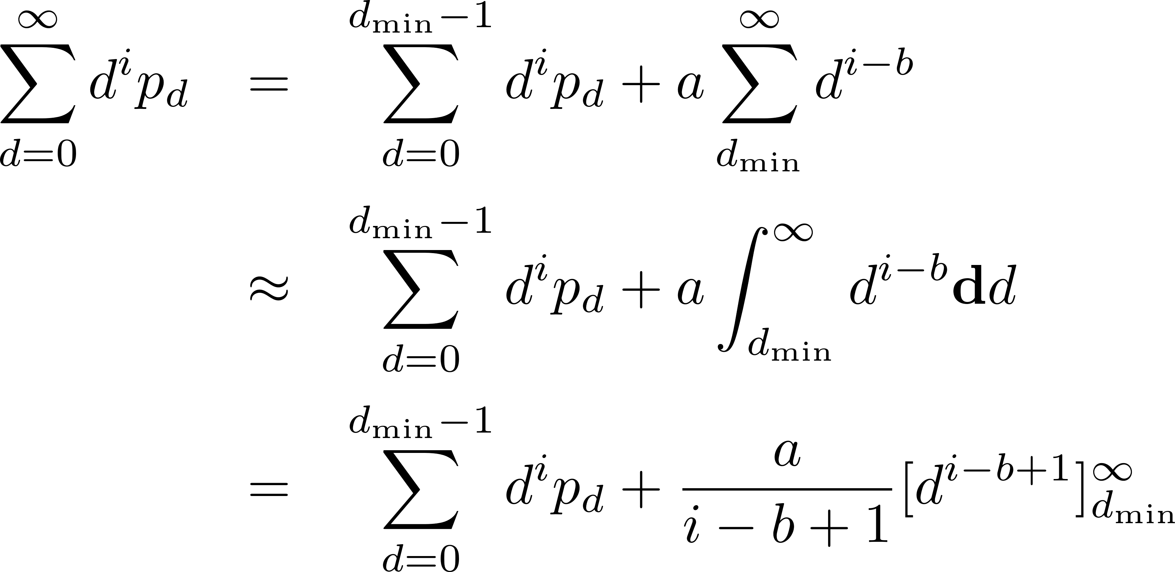
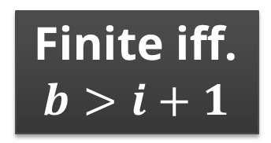
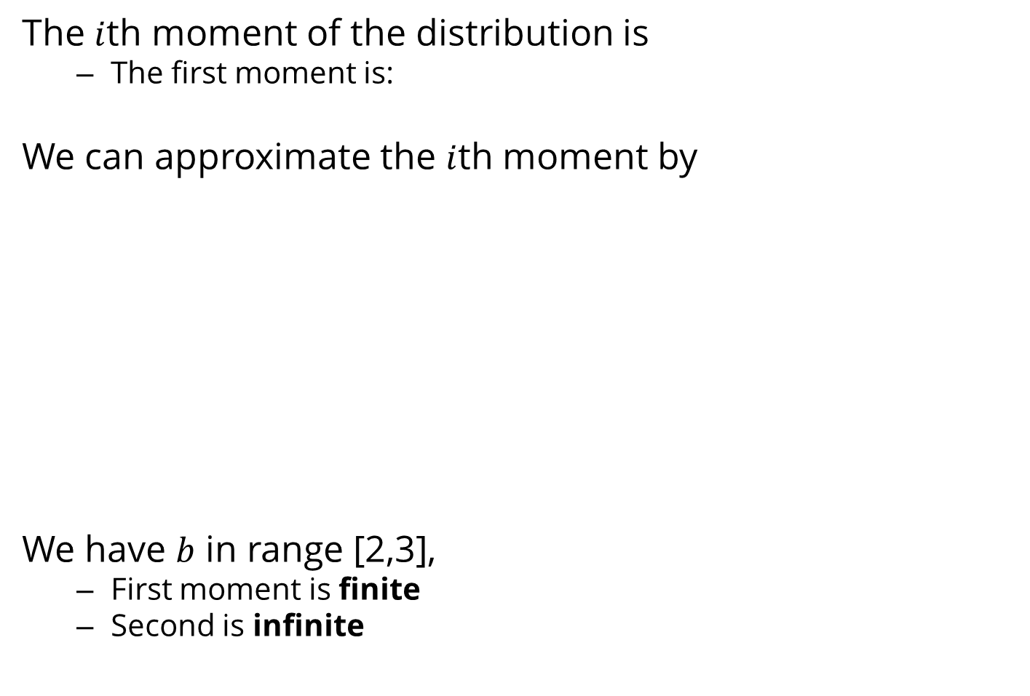
Moments of Power-Law Degree Distribution
The $i$th moment of the distribution is
The first moment is:
We can approximate the $i$th moment by
We have $b$ in range [2,3],
First moment is finite
Second is infinite
the mean
Finite iff.
$$b>i+1$$

Slide 13
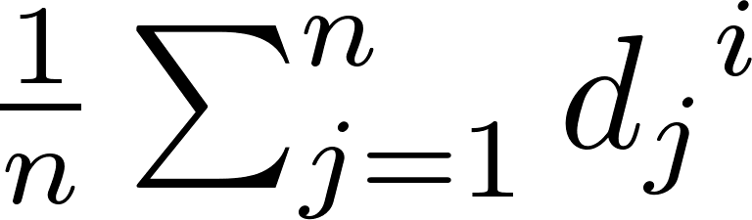
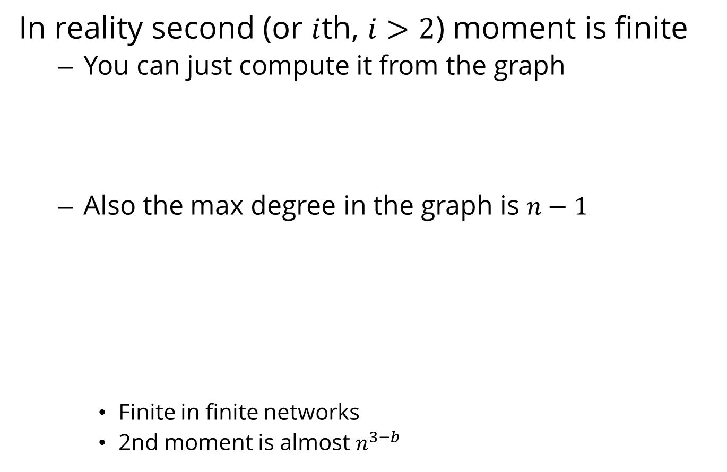
More on Moments
In reality second (or $i$th, $i>2$) moment is finite
You can just compute it from the graph
Also the max degree in the graph is $n−1$
Finite in finite networks
2nd moment is almost $n^{3−b}$

Slide 14
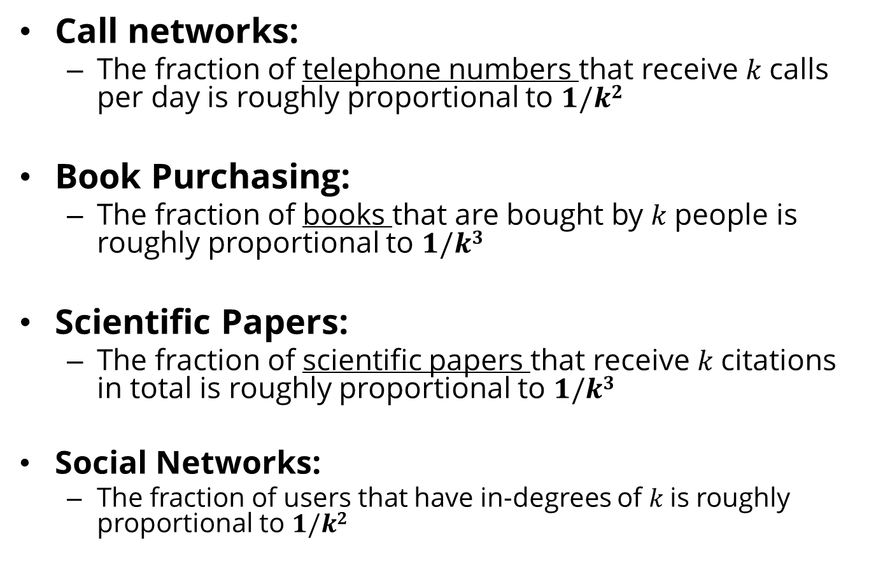
Power-Law Distribution: Examples
Call networks:
The fraction of telephone numbers that receive $k$calls per day is roughly proportional to $1/k2$
Book Purchasing:
The fraction of books that are bought by $k$people is roughly proportional to $1/k3$
Scientific Papers:
The fraction of scientific papers that receive $k$citations in total is roughly proportional to $1/k3$
Social Networks:
The fraction of users that have in-degrees of $k$is roughly proportional to $1/k2$

Slide 15
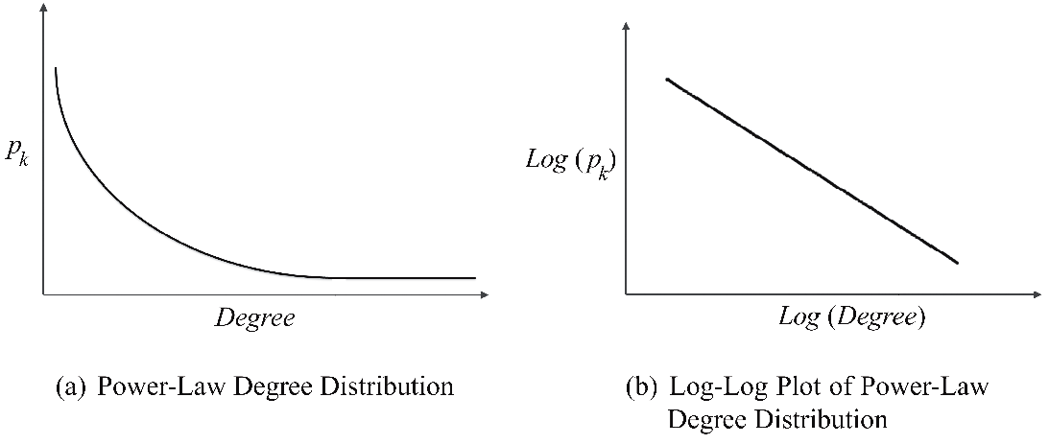

Power-Law Distribution
A typical shape of a power-law distribution
Many real-world networks exhibit a power-law distribution.
Power-laws seem to dominate
When the quantity being measured can be viewed as a type of popularity.
A power-law distribution
Small occurrences: common
Large instances: extremely rare
Log-Log plot

Slide 16
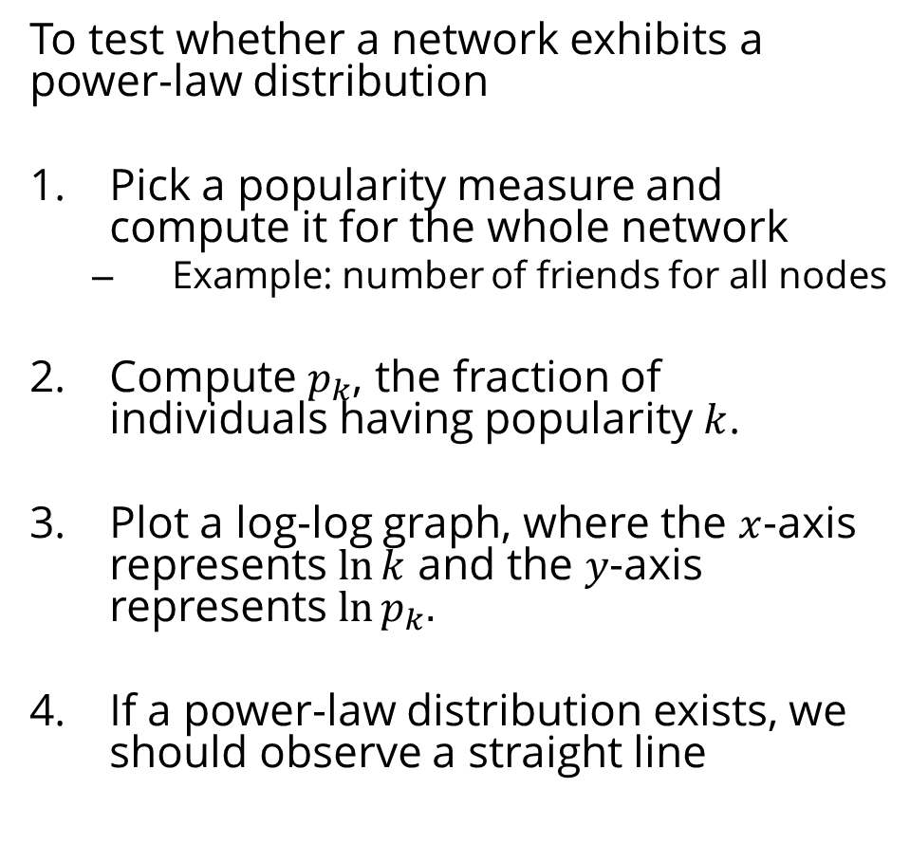
Power-law Distribution: An Elementary Test
To test whether a network exhibits a power-law distribution
Pick a popularity measure and compute it for the whole network
Example: number of friends for all nodes
Compute $p_{k}$, the fraction of individuals having popularity $k$.
Plot a log-log graph, where the $x$-axis represents $ln⁡k$ and the $y$-axis represents $ln⁡p_{k}.$
If a power-law distribution exists, we should observe a straight line
This is not a systematic approach!
Other distributions could also exhibit this pattern
The results [estimations for parameters] can be biased and incorrect
For a systematic approach see:
Clauset, Aaron, Cosma Rohilla Shalizi, and Mark EJ Newman. "Power-law distributions in empirical data." SIAM review 51(4) (2009): 661-703.

Slide 17
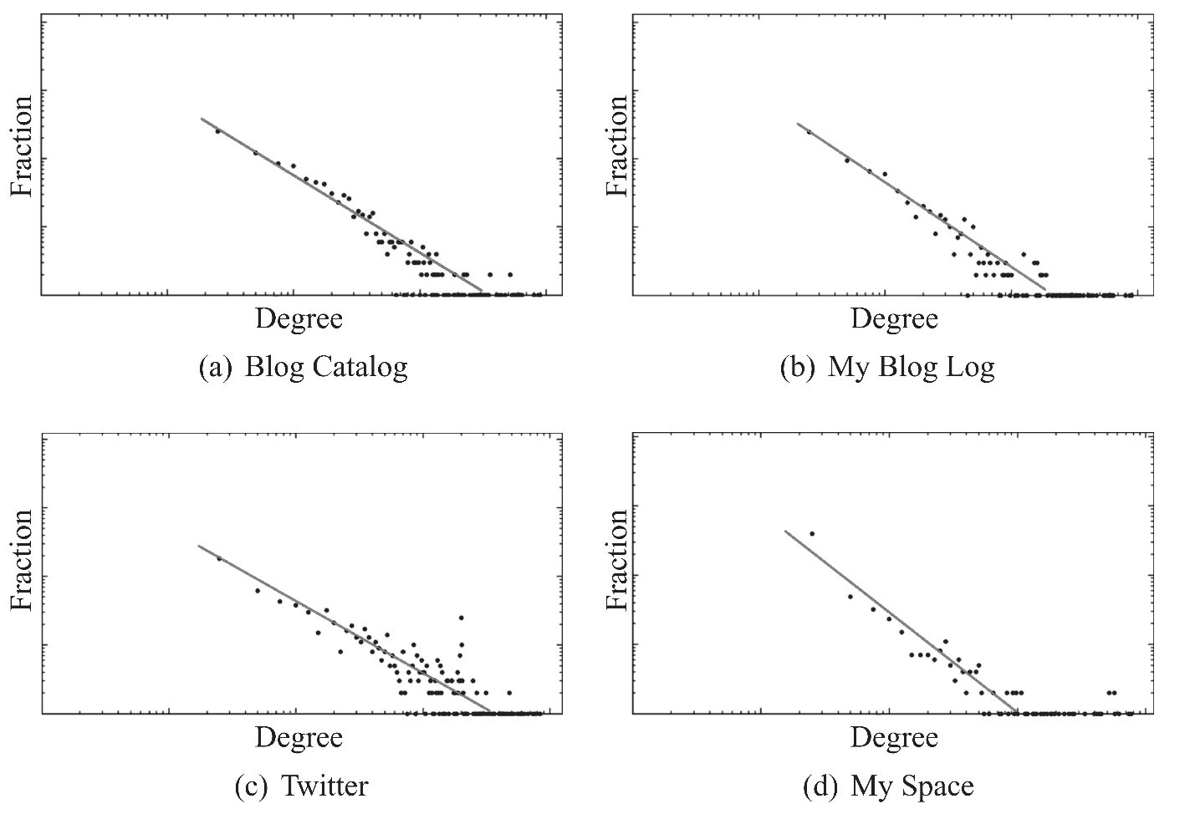
Power-Law Distribution: Real-World Networks
Networks with a power-law degree distribution are called Scale-Free networks

Slide 18
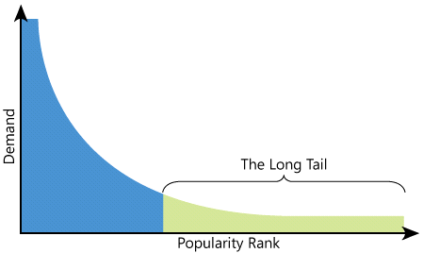

The tail of the power-law distribution is long!
The Loooooong Tail
Are most sales being generated by a small set of items that are enormously popular?
OR
By a much larger population of items that are each individually less popular?
The total sales volume of unpopular items, taken together, is very significant.
57% of Amazon’s sales is from the long tail

Slide 19
Clustering Coefficient

Slide 20
Clustering Coefficient
In real-world networks, friendships are highly transitive
Facebook
May 2011:
Average clustering coefficient of 0.5 for users with two friends
Friends of a user are often friends with one another
These friendships form triads
High average [local] clustering coefficient

Slide 21
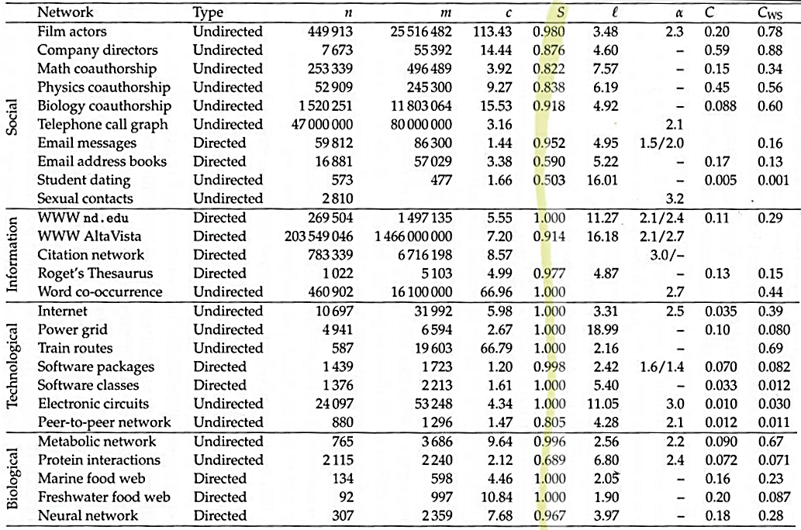
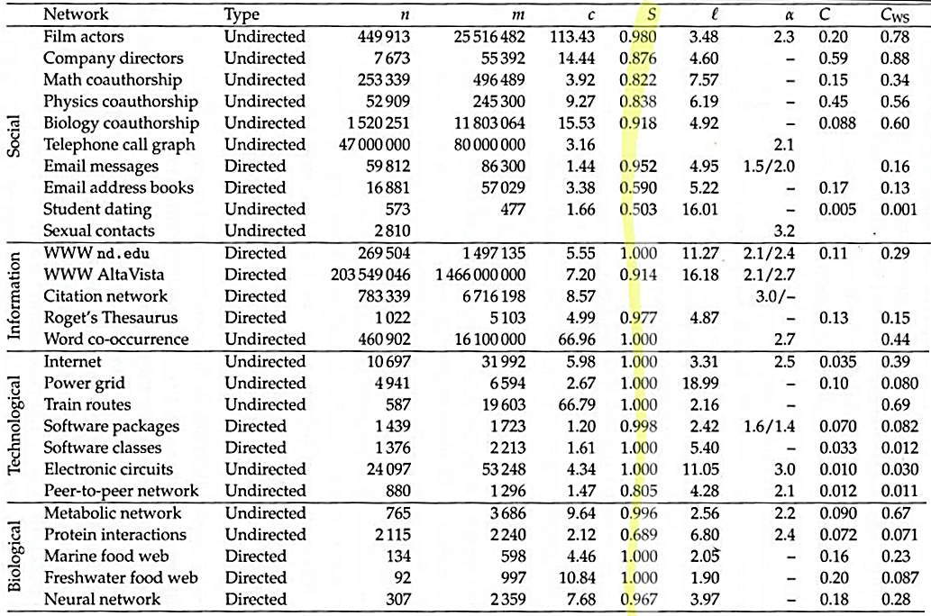
Clustering Coefficient for Real-World Networks
Source: M. E. J Newman

Slide 22
Average Path Length

Slide 23
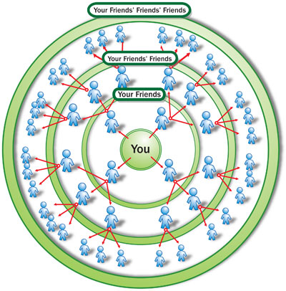
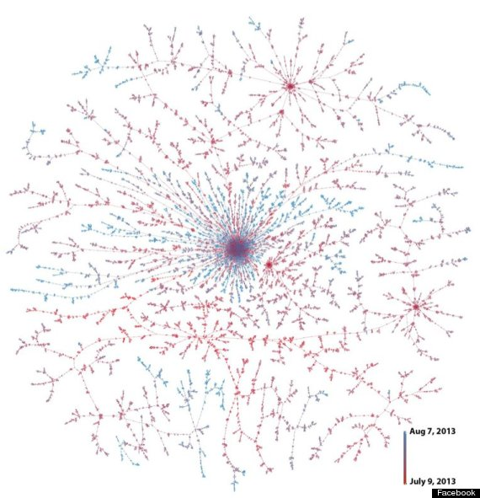
How Small is the World?
A rumor is spreading over a social network.
Assume all users pass it immediately to all of their friends
Rumor Spreading on Facebook
How long does it take to reach almost all of the nodes in the network?
What is the maximum time?
What is the average time?
Notes:
Image source: http://computer.howstuffworks.com/internet/social-networking/networks/friendster3.htm

Slide 24
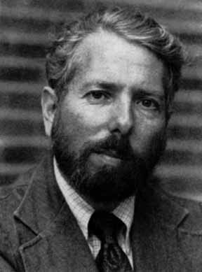
Milgram’s Experiment
296 random people from Nebraska (196 people) and Boston (100 people) were asked to send a letter (via intermediaries) to a stock broker in Boston
S/he could only send to people they personally knew, i.e., were on a first-name basis
Stanley Milgram (1933-1984)
Among the letters that found the target (64), the average number of links was around six.

Slide 25
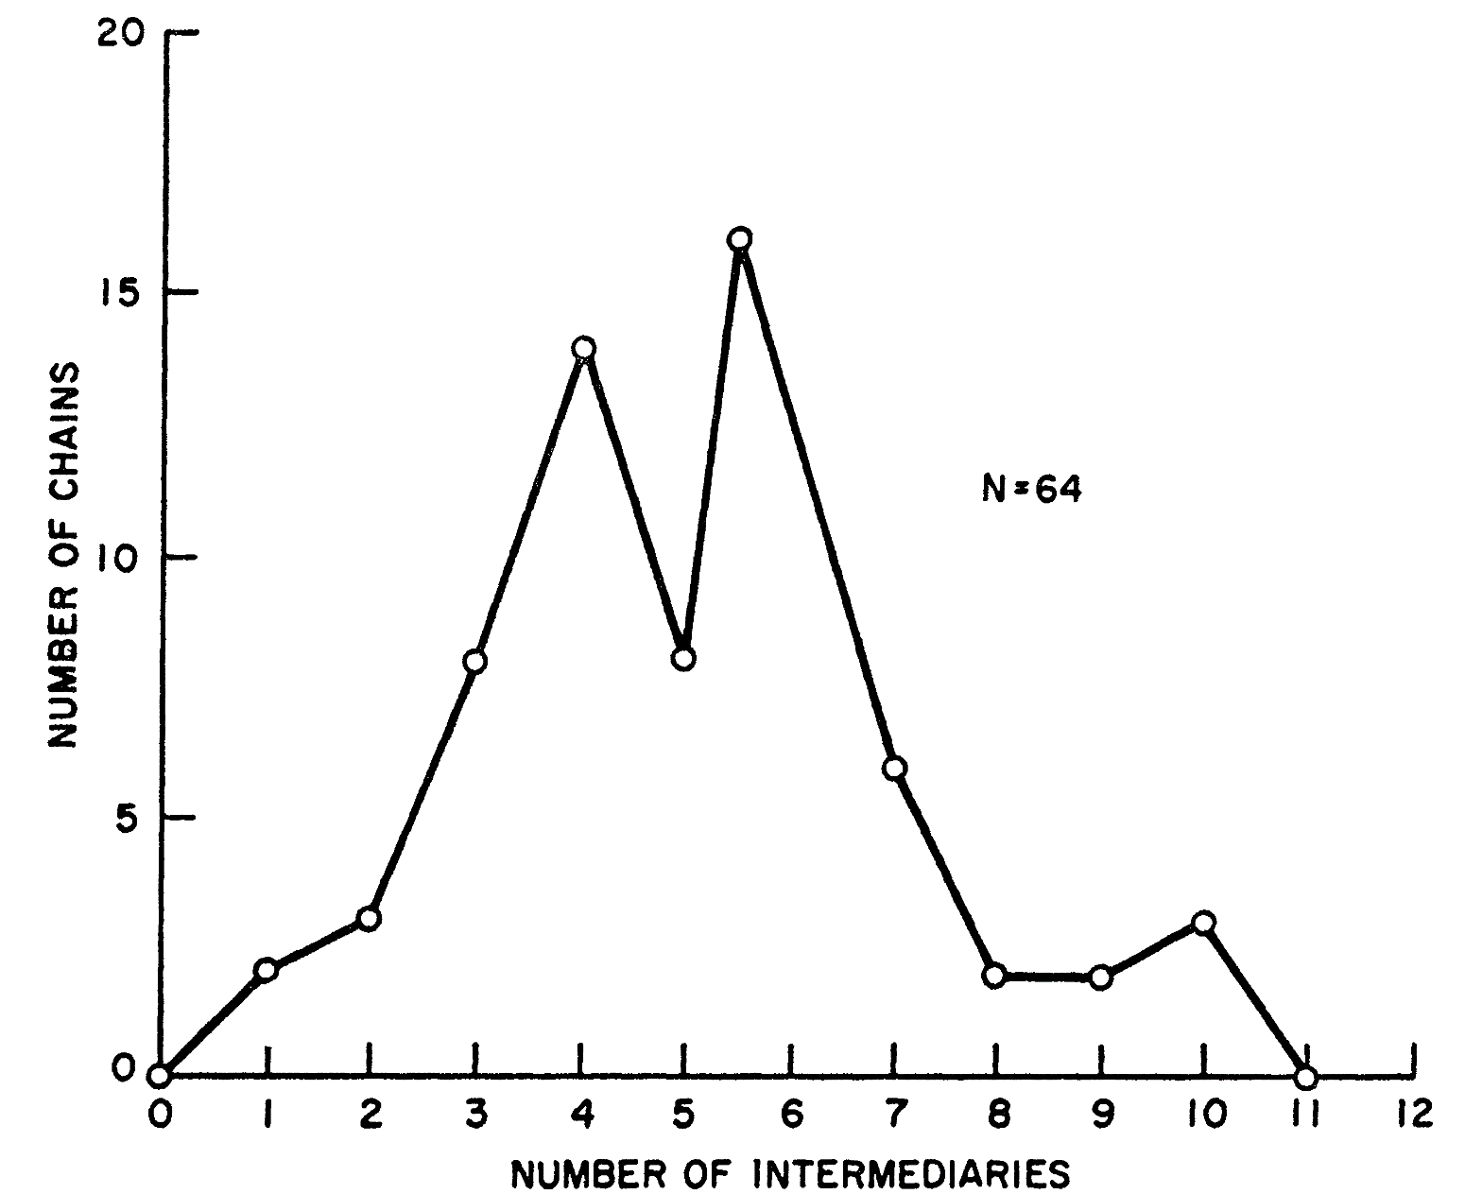
Milgram’s Experiment
Travers, Jeffrey, and Stanley Milgram. "An experimental study of the small world problem." Sociometry (1969): 425-443.
Average Number of Intermediate people is 5.2

Slide 26
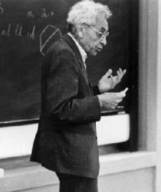
Erdös Number
Erdös Number: Number of links required to connect scholars to Erdös, via co-authorship papers
Erdös wrote 1500+ papers with 507 co-authors.
The Erdös Number Project allows you to compute your Erdös number:
http://www.oakland.edu/enp/
Connecting path lengths, among mathematicians only:
Avg. is 4.65 and Maximum is 13
Paul Erdös (1913-1996)
Watch Erdös’s documentary “N is a number” on YouTube

Slide 27
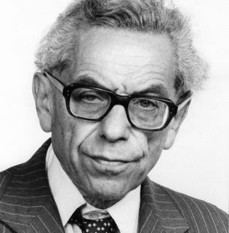
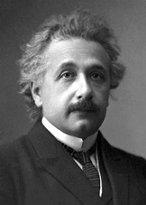
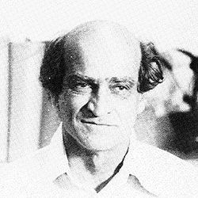
An Example of Erdös number 2 [Einstein]
Paul Erdös (1913-1996)
Albert Einstein (1879-1955)
Erdös, Paul, B. Rothschild, and E. G. Straus. "Polychromatic Euclidean Ramsey theorems." Journal of Geometry 20.1 (1983): 28-35.
Ernst Gabor Straus
(1922-1983)
Einstein, Albert, and Ernst Gabor Straus. "A generalization of the relativistic theory of gravitation, II." Annals of Mathematics (1946): 731-741.

Slide 28
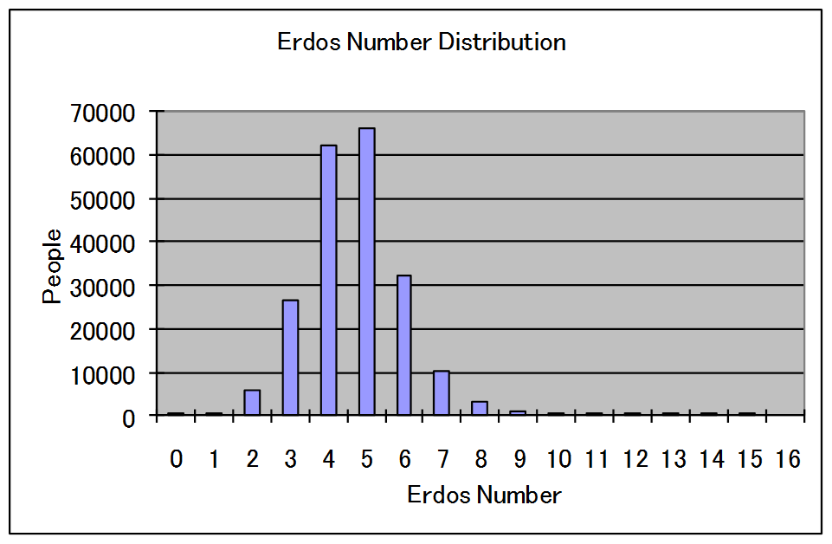
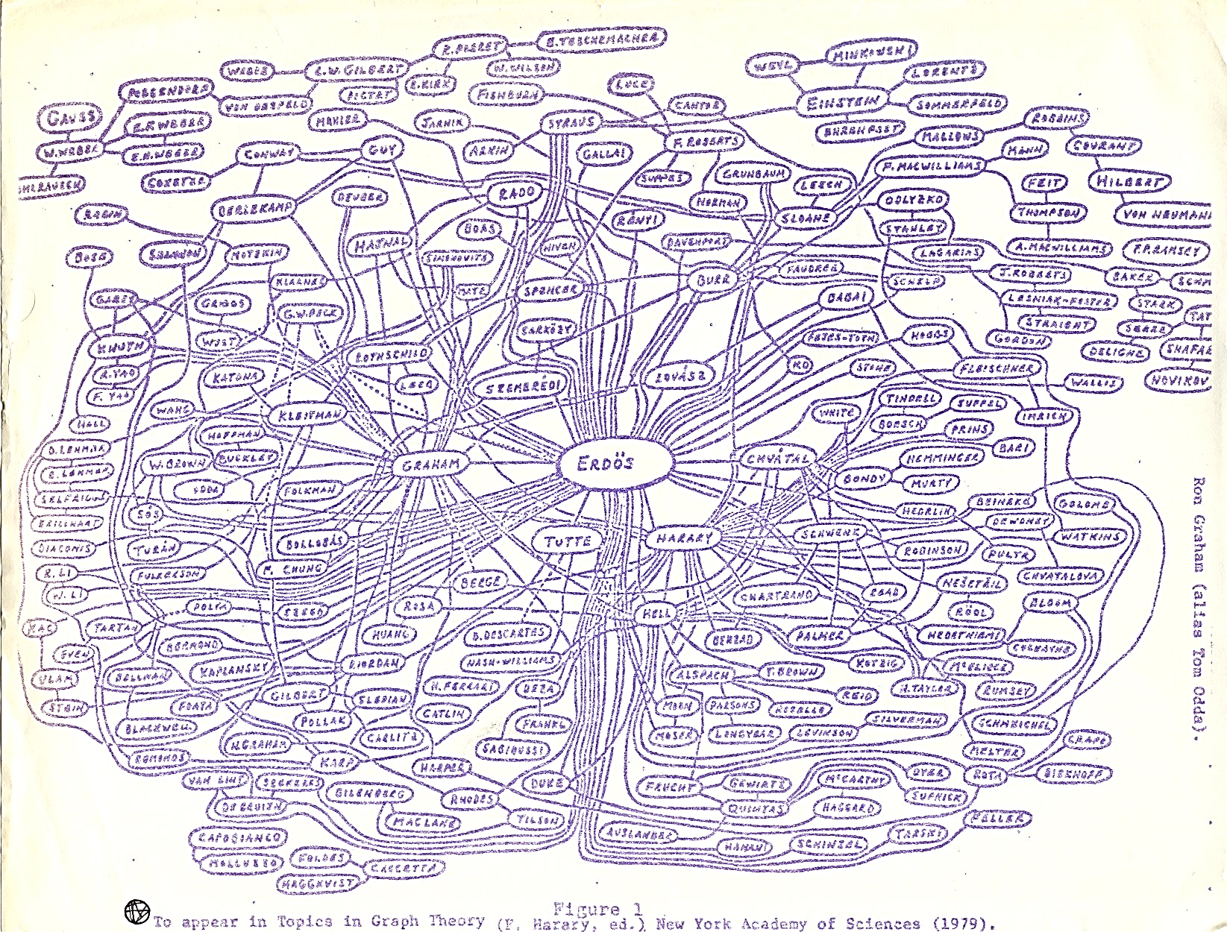
Erdös number Distribution
The median Erdös number is 5
The mean is 4.65
The standard deviation is 1.27
Erdös Number Project:
http://www.oakland.edu/enp/index.html

Slide 29
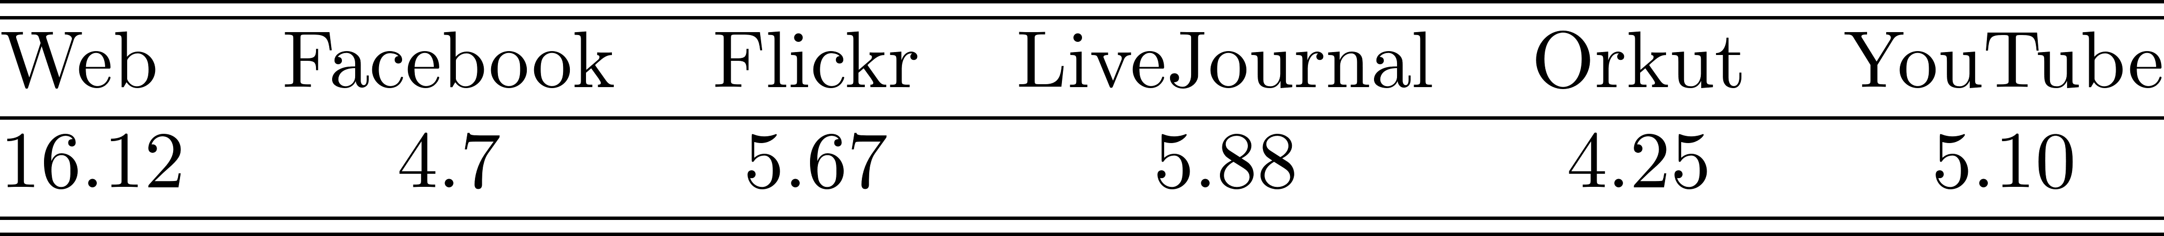
The Average Shortest Path
In real-world networks, any two members of the network are usually connected via a short paths.
Facebook
May 2011:
Average path length was 4.7
4.3 for US users
[Four degrees of separation]
The average path length is small

Slide 30
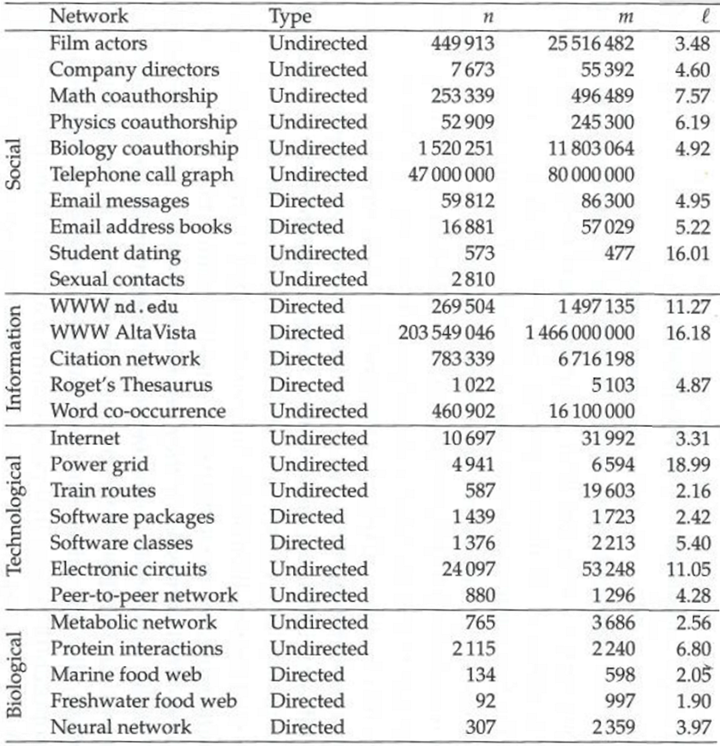
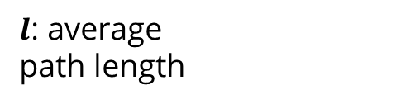
The Average Shortest Path in Sample Networks
$l$: average
path length
Source: M. E. J Newman

Slide 31
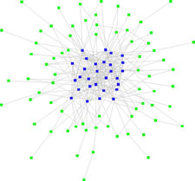


More Properties of Real-World Networks
Friendship Paradox [Feld 1991]
i.e., you friends, on average, have more friends than you
Why?
High degree nodes appear in many averages when averaging over friends
It holds for 98% of Twitter Users [Hodas et al. 2013]
Core-Periphery Structure
Dense Core
Periphery nodes that connects to
the core, but not connected among
themselves
Also known as
Jellyfish or Octopus structures

Slide 32
Network Models - Model-Driven Models!
Random graphs
Small-World Model
Preferential Attachment

Slide 33
Random Graphs

Slide 34
Random Graphs
We have to assume how friendships are formed
The most basic form:
Random Graph assumption:
Edges (i.e., friendships) between nodes (i.e., individuals) are formed randomly.
We discuss two random graph models $G(n,p)$ and $G(n,m)$

Slide 35
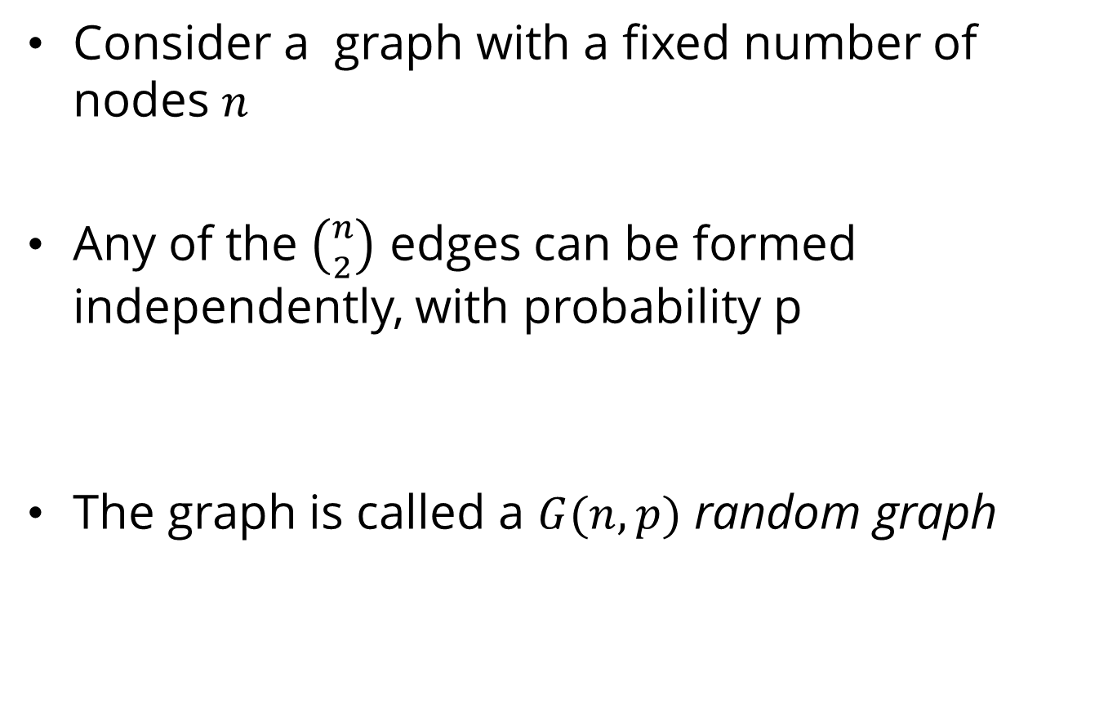
Random Graph Model - $G(n,p)$
Consider a graph with a fixed number of nodes $n$
Any of the $\left({n \atop 2}\right)$ edges can be formed independently, with probability p
The graph is called a $G(n,p)$ random graph
Proposed independently by Edgar Gilbert and by Solomonoff and Rapoport.

Slide 36
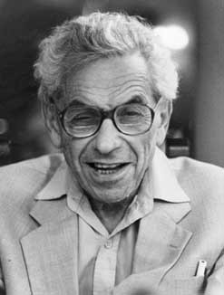
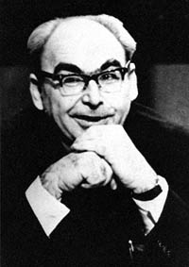
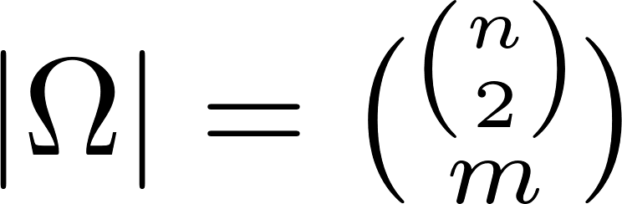
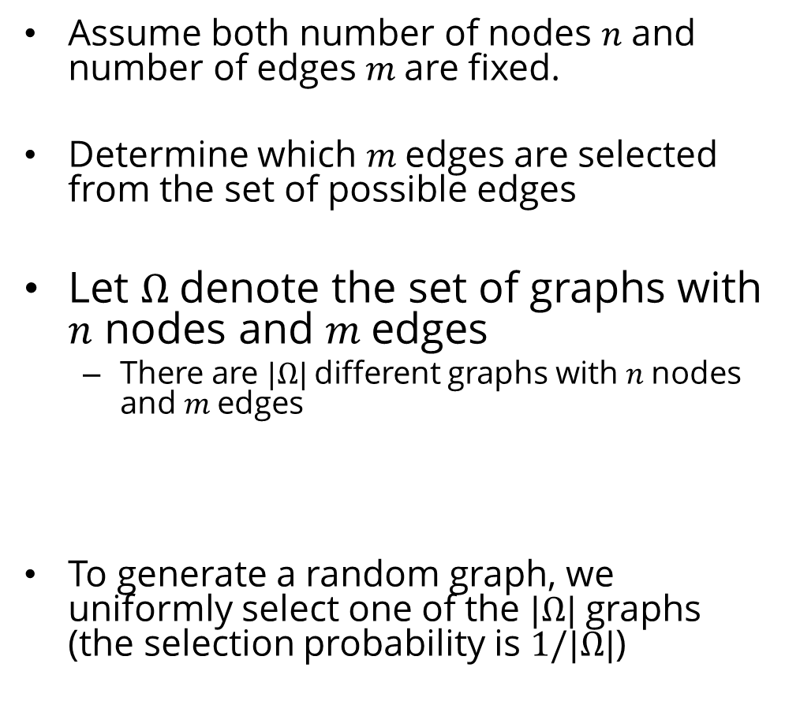
Random Graph Model - $G(n,m)$
Assume both number of nodes $n$ and number of edges $m$are fixed.
Determine which $m$edges are selected from the set of possible edges
Let $Ω$denote the set of graphs with $n$ nodes and $m$edges
There are $|Ω|$different graphs with $n$nodes and $m$edges
To generate a random graph, we uniformly select one of the $|Ω|$graphs (the selection probability is $1/|Ω|$)
This model was first proposed by
Paul Erdös and Alfred Rényi

Slide 37
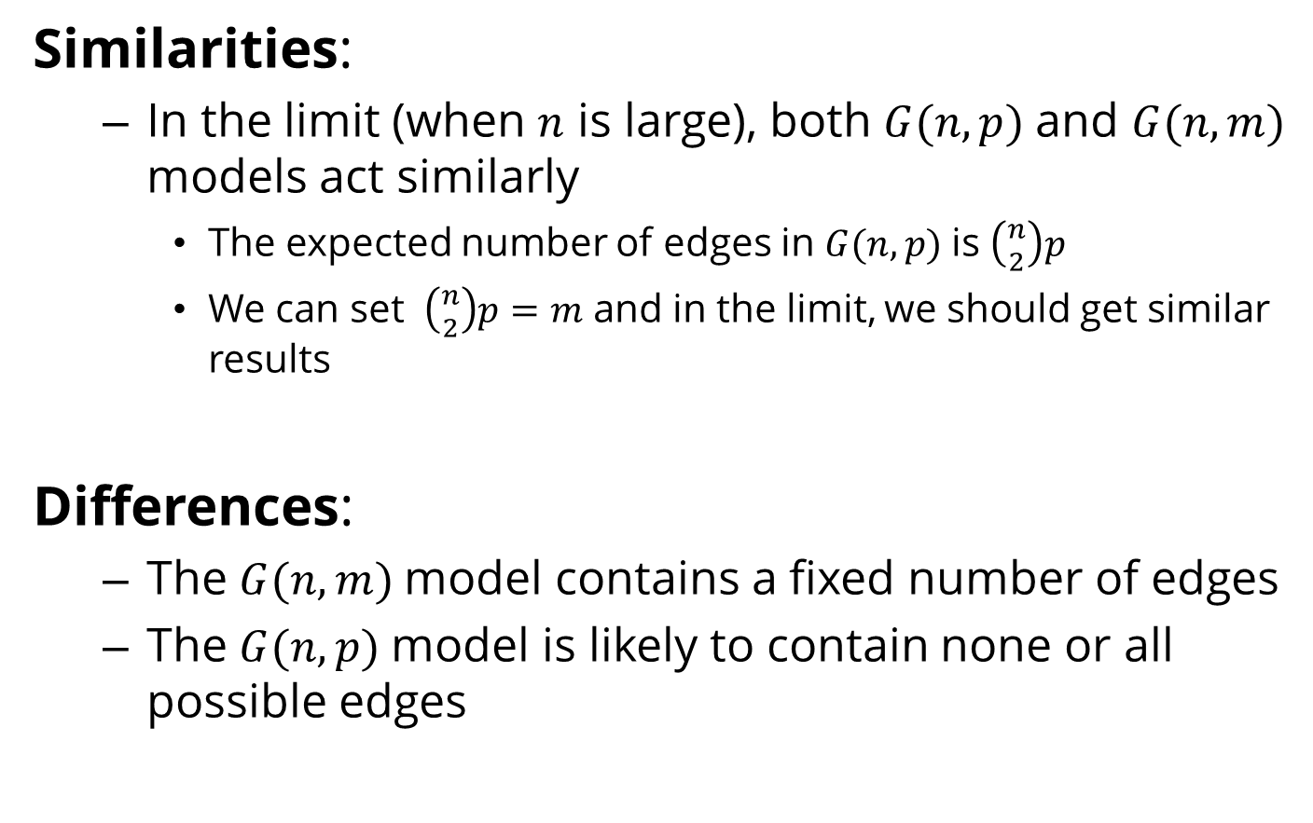
Modeling Random Graphs, Cont.
Similarities:
In the limit (when $n$ is large), both $G(n, p)$and $G(n, m)$ models act similarly
The expected number of edges in $G(n, p)$is $\left({n \atop 2}\right)p$
We can set $\left({n \atop 2}\right)p=m$ and in the limit, we should get similar results
Differences:
The $G(n, m)$model contains a fixed number of edges
The $G(n, p)$model is likely to contain none or all possible edges

Slide 38
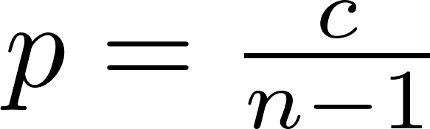
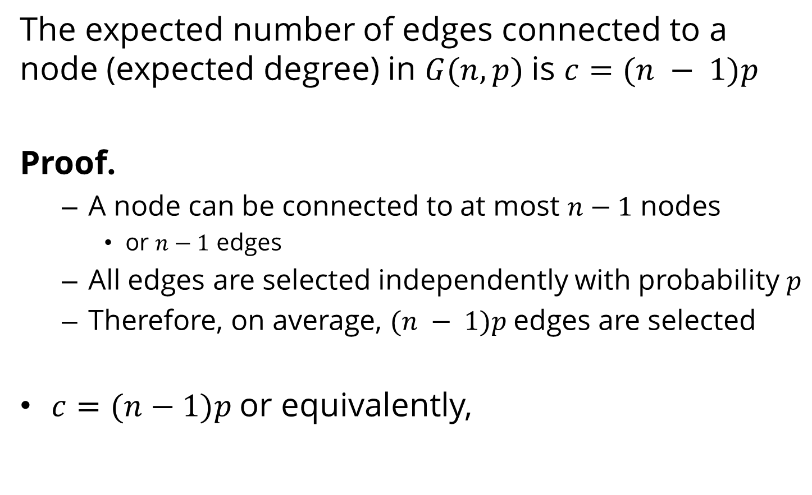
Expected Degree
The expected number of edges connected to a node (expected degree) in $G(n, p)$is $c=(n − 1)p$
Proof.
A node can be connected to at most $n−1$ nodes
or $n−1$ edges
All edges are selected independently with probability $p$
Therefore, on average, $(n − 1)p$edges are selected
$c=(n−1)p$or equivalently,

Slide 39
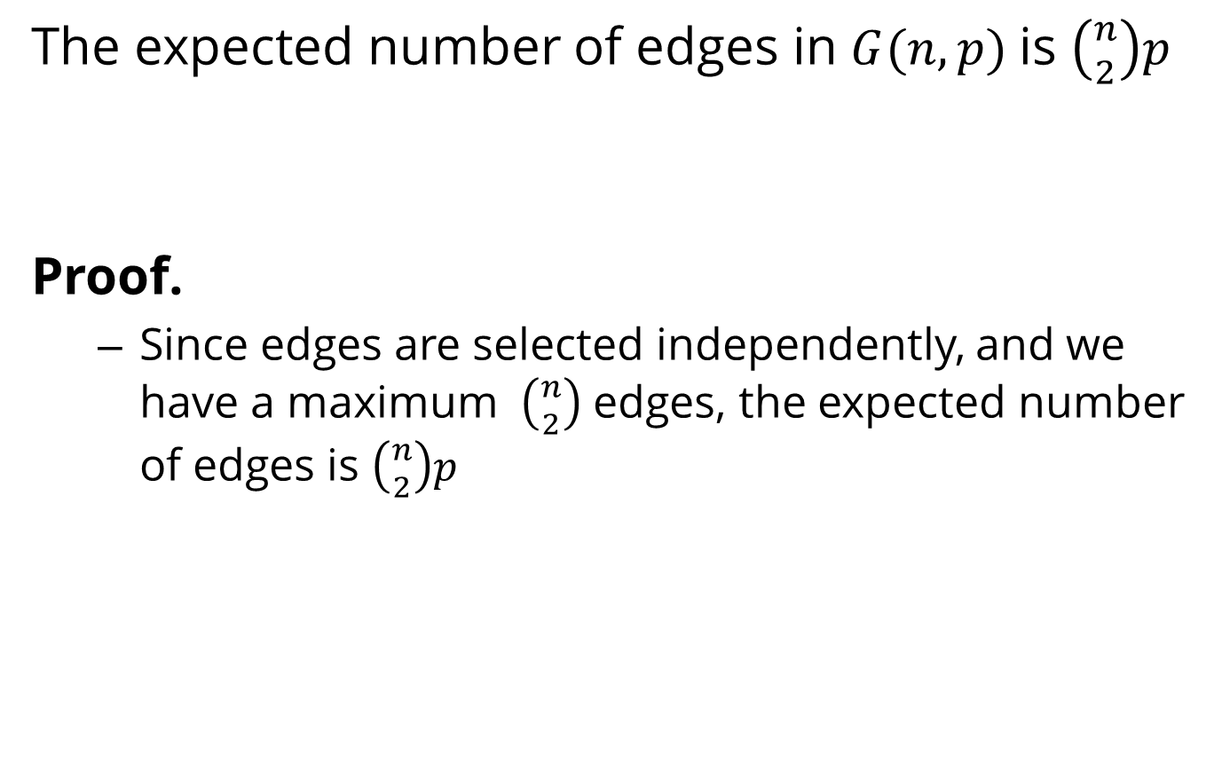
Expected Number of Edges
The expected number of edges in $G(n, p)$is $\left({n \atop 2}\right)p$
Proof.
Since edges are selected independently, and we have a maximum $\left({n \atop 2}\right)$ edges, the expected number of edges is $\left({n \atop 2}\right)p$

Slide 40
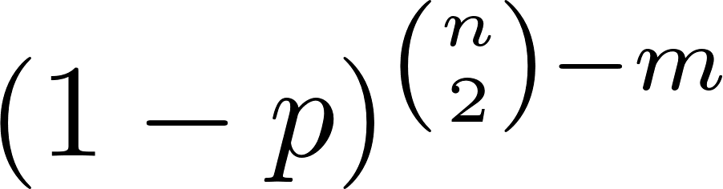
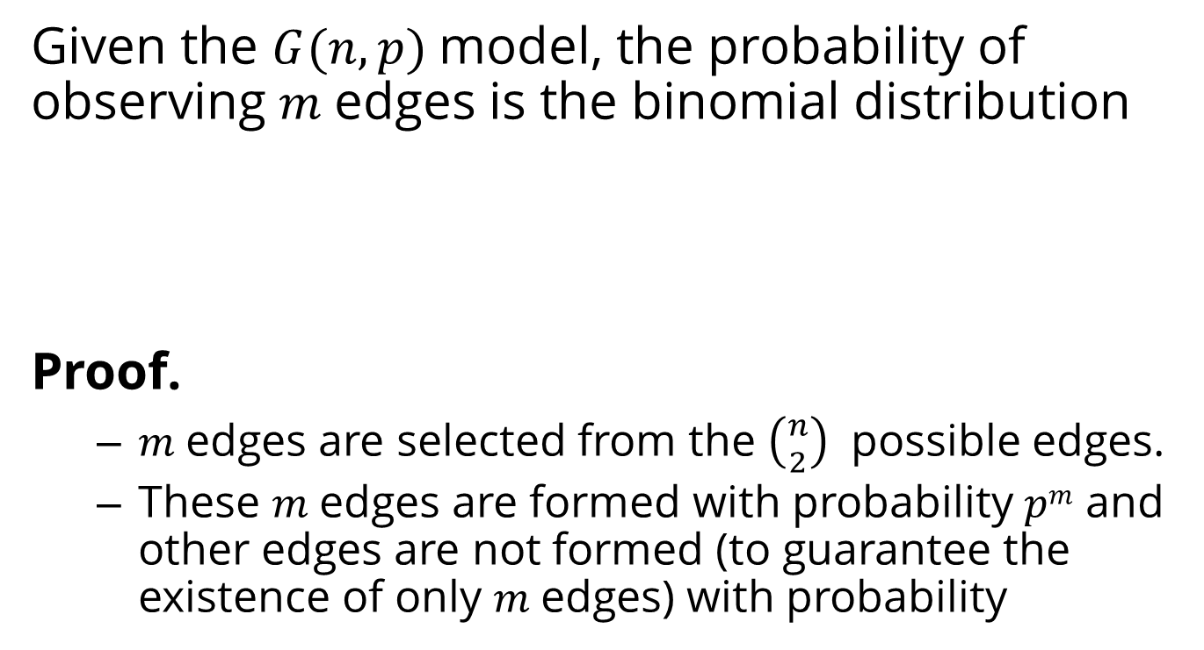
The probability of observing $m$edges
Given the $G(n, p)$model, the probability of observing $m$edges is the binomial distribution
Proof.
$m$edges are selected from the $\left({n \atop 2}\right)$ possible edges.
These $m$edges are formed with probability $pm$ and other edges are not formed (to guarantee the existence of only $m$edges) with probability

Slide 41
Evolution of Random Graphs
Create your own Random Graph Evolution demo: https://github.com/dgleich/erdosrenyi-demo

Slide 42


The Giant Component
In random graphs, as we increase $p$, a large fraction of nodes start getting connected
i.e., we have a path between any pair
This large fraction forms a connected component:
Largest connected component, also known as the Giant component
In random graphs:
$p=0$
the size of the giant component is $0$
$p=1$
the size of the giant component is $n$
GIANT
COMPONENT

Slide 43






The Giant Component
Probability ($p$)
Average Node Degree ($c$)
Diameter
Giant Component Size
Average Path Length
0.0
0.0
0
0
0.0
0.055
0.8
2
4
1.5
0.11
≈1
6
7
2.66
$$1.0$$
n-1=9
$$1$$
$$10$$
$$1.0$$

Slide 44

Demo ($n=150$)
From David Gleich

Slide 45

1st Phase Transition (Rise of the Giant Component)
Phase Transition: the point where diameter value starts to shrink in a random graph
We have other phase transitions in random graphs
E.g., when the graph becomes connected
The phase transition we focus on happens when
average node degree $c = 1$ (or when $p = 1/(n−1)$)
At this Phase Transition:
The giant component, which just started to appear, starts to grow, and
The diameter, which just reached its maximum value, starts decreasing.
Notes:
c: mean degree

Slide 46

Random Graphs
Percentage of nodes in largest component
Diameter of largest component (not to scale)
If $c < 1$:
small, isolated clusters
small diameters
short path lengths
At $c = 1$:
a giant component appears
diameter peaks
path lengths are long
For $c > 1$:
almost all nodes connected
diameter shrinks
path lengths shorten
1.0
0
1.0
c
phase transition
Notes:
c – average node degree

Slide 47



Why $c=1$? [Rough Idea]
Consider a random graph with expected node degree $c$
In this graph,
Consider any connected set of nodes $S$;
Let $S’ =V−S$ denote the complement set; and
Assume $|S| <<|S’|.$
For any node $v$ in $S,$
If we move one hop away from $v$, we visit approximately $c$ nodes.
If we move one hop away from nodes in $S$,
we visit approximately $|S|c$nodes.
If $S$ is small, the nodes in $S$ only visit nodes in $S’$ and when moving one hop away from $S$, the set of nodes guaranteed to be connected gets larger by a factor $c$.
In the limit, if we want this connected component to become the largest component, then after traveling $n$ hops, its size must grow and we must have
Notes:
c: mean degree

Slide 48
Properties of Random Graphs

Slide 49

Degree Distribution
When computing degree distribution, we estimate the probability of observing $P(d_{v}=d)$for node $v$
For a random graph generated by $G(n,p)$, this probability is
This is a binomial degree distribution. In the limit this will become the Poisson degree distribution

Slide 50


Binomial Distribution in the Limit
Poison
Distribution

Slide 51




2nd Phase Transition (Connectivity)
When the graph is connected there are no nodes with degree 0
So, $P\left(d_{v}=0\right)=e^{−c}$should be less than $1/n$
Connectivity Threshold

Slide 52

Expected Local Clustering Coefficient
The expected local clustering coefficient for node $v$ of a random graph generated by $G(n, p)$is $p$
Proof.
$v$can have different degrees depending on the random procedure so the expected value is

Slide 53

Expected Local Clustering Coefficient, Cont.
Sums up to 1

Slide 54

Global Clustering Coefficient
The global clustering coefficient of a random graph generated by $G(n, p)$ is $p$
Proof.
The global clustering coefficient defines the probability of two neighbors of the same node being connected.
In a random graph, for any two nodes, this probability is the same
Equal to the generation probability $p$that determines the probability of two nodes getting connected

Slide 55




The Average Path Length [Rough Idea]
The average path length in a random graph is
Proof.
Assume $D$is the expected diameter of the graph
Starting with any node and the expected degree $c$,
one can visit approximately $c$nodes by traveling one edge
$c^{2}$ nodes by traveling $2$edges, and
$c^{D}$ nodes by traveling diameter number of edges
We should have visited all nodes
The expected diameter size tends to the average path length $l$ in the limit

Slide 56

Modeling with Random Graphs
Compute the average degree $c$ in the real-world graph
Compute $p$ using $c/(n−1)= p$
Generate the random graph using $p$
How representative is the generated graph?
[Degree Distribution] Random graphs do not have a power-law degree distribution
[Average Path Length] Random graphs perform well in modeling the average path lengths
[Clustering Coefficient] Random graphs drastically underestimate the clustering coefficient

Slide 57

Real-World Networks / Simulated Random Graphs

Slide 58
Small-World Model

Slide 59


Small-world Model
Small-world model
or the Watts-Strogatz (WS) model
A special type of random graph
Exhibits small-world properties:
Short average path length
High clustering coefficient
It was proposed by Duncan J. Watts and Steven Strogatz in their joint 1998 Nature paper
Watts, Duncan J., and Steven H. Strogatz. "Collective dynamics of ‘small-world’networks." nature 393.6684 (1998): 440-442.

Slide 60


Small-world Model
In real-world interactions, many individuals have a limited and often at least, a fixed number of connections
In graph theory terms, this assumption is equivalent to embedding users in a regular network
A regular (ring) lattice is a special case of regular networks where there exists a certain pattern on how ordered nodes are connected to one another
In a regular lattice of degree $c$, nodes are connected to their previous $c/2$ and following $c/2$neighbors
Formally, for node set V={$v_{1},$ $v_{2},$ $v_{3}$,…, $v_{n}\}$, an edge exists between node $i$and $j$if and only if

Slide 61


Generating a Small-World Graph
The lattice has a high, but fixed, clustering coefficient
The lattice has a high average path length
In the small-world model, a parameter $0≤β≤1$ controls randomness in the model
When $β$ is 0, the model is basically a regular lattice
When $β=1$, the model becomes a random graph
The model starts with a regular lattice and starts adding random edges [through rewiring]
Rewiring: take an edge, change one of its end-points randomly

Slide 62
Constructing Small World Networks
As in many network generating algorithms
Disallow self-edges
Disallow multiple edges

Slide 63
Small-World Model Properties

Slide 64
Degree Distribution
The degree distribution for the small-world model is
In practice, in the graph generated by the small world model, most nodes have similar degrees due to the underlying lattice.

Slide 65


Regular Lattice vs. Random Graph
Regular Lattice:
Clustering Coefficient (high):
Average Path Length (high): $n/2c$
Random Graph:
Clustering Coefficient (low): $p$
Average Path Length (ok!) : $ln⁡|V|/ ln⁡c$

Slide 66

What happens in Between?
Does smaller average path length mean smaller clustering coefficient?
Does larger average path length mean larger clustering coefficient?
Numerical simulation:
We increase $p$ (i.e., $β$) from 0 to 1
Assume
$L(0)$ is the average path length of the regular lattice
$C(0)$is the clustering coefficient of the regular lattice
For any $p$, $L(p)$ denotes the average path length of the small-world graph and $C(p)$ denotes its clustering coefficient
Observations:
Fast decrease of average distance $L(p)$
Slow decrease in clustering coefficient $C(p)$

Slide 67

Change in Clustering Coefficient /Avg. Path Length
Exact analytical solution
Sweet Spot:
Small World
No exact analytical solution
1% of links rewired
10% of links rewired
Notes:
When p = 0, it is a regular lattice – l(0) and C(0) average path length and clustering coefficient for a lattice.

Slide 68


Clustering Coefficient for Small-world model
The probability that a connected triple stays connected after rewiring consists of
The probability that none of the 3 edges were rewired is ${(1−p)}^{3}$
The probability that other edges were rewired back to form a connected triple
Very small and can be ignored
Clustering coefficient

Slide 69

Modeling with the Small-World Model
Given a real-world network in which average degree is $c$and clustering coefficient $C$is given,
we set $C(p) = C$ and determine $β$ $(=p)$ using equation
Given $β$, $c$, and $n$(size of the real-world network), we can simulate the small-world model

Slide 70

Real-World Network and Simulated Graphs

Slide 71
Preferential Attachment Model

Slide 72




Preferential Attachment Model
Main assumption:
When a new user joins the network, the probability of connecting to existing nodes is proportional to existing nodes’ degrees
For the new node $v$
Connect $v$to a random node $vi$ with probability
Proposed by Albert-László Barabási and Réka Albert
A special case of the Yule process
Distribution of wealth in the society:
The rich get richer
Barabási, Albert-László, and Réka Albert. "Emergence of scaling in random networks." science 286.5439 (1999): 509-512.

Slide 73








Preferential Attachment: Example
Node $v$arrives
$P(1) =1/7$
$P(2) =1/7$
$P(3) =2/7$
$P(4) =0$
$P(5) =3/7$
$$P(1)=1/7$$
$$v$$
$$P(5)=3/7$$
$$P(2)=1/7$$
$$P(4)=0$$
1
5
$$P(3)=2/7$$
2
3
4

Slide 74
Constructing Scale-free Networks

Slide 75
Properties of the Preferential Attachment Model

Slide 76



Properties
Degree Distribution:
Clustering Coefficient:
Average Path Length:

Slide 77

Modeling with the Preferential Attachment Model
Similar to random graphs, we can simulate real-world networks by generating a preferential attachment model by setting the expected degree $m$
See Algorithm 4.2 in the book

Slide 78

Real-World Networks and Simulated Graphs

Slide 79

Unpredictability of the Rich-Get-Richer Effects
The initial stages of one’s rise to popularity are fragile
Once a user is well established, the rich-get-richer dynamics of popularity is likely to push the user even higher
But getting the rich-get-richer process started in the first place is full of potential accidents and near-misses
If we could roll time back to 1997, and then run history forward again, would the Harry Potter books again sell hundreds of millions of copies?
See more: Salganik, Matthew J., Peter Sheridan Dodds, and Duncan J. Watts. "Experimental study of inequality and unpredictability in an artificial cultural market." science 311.5762 (2006): 854-856.

Slide 80
Network Models Extended - Model-Driven Models!
Configuration Model
Kleinberg Small-World Model
Vertex Copying Model

Slide 81
Configuration Model

Slide 82

Configuration Model
Problem: the degree distribution in random graphs is now power law
Binomial for small $n$ and Poisson for large $n$
Solution:
Given a degree sequence, ensure that the graph generated has that degree sequence.
The degree sequence can
Come from a real-world graph
Be sampled from a degree distribution, i.e., power law

Slide 83

















Configuration Model
I. Given the degree sequence $d_{1},$ $d_{2}, …,d_{n}$ generate $n$ nodes, such that node $i$ has $d_{i}$ stubs (also known as half-edges)
Stub
II. Randomly match stubs until no edges there are no more stubs
You can have loops and multiple edges
Each configuration (not each graph!) appears with equal probability
You can get the same graph
$$a_{1}$$
$$b_{1}$$
$$a_{2}$$
$$b_{2}$$
$$a_{2}$$
$$a_{1}$$
$$b_{1}$$
$$a_{1}$$
$$b_{1}$$
$$b_{1}$$
$$a_{2}$$
$$b_{2}$$
$$a_{1}$$
$$b_{2}$$
$$a_{2}$$
$$b_{2}$$

Slide 84

How to generate the Configuration model
Create a list where the node id for node $v_{i}$ with degree $d_{i}$ is repeated $d_{i}$ times
Shuffle the list
Starting from the first index, join adjacent nodes
Example: Degree sequence $(2,2,2)$
$$v_{1}$$ | $$v_{1}$$ | $$v_{2}$$ | $$v_{2}$$ | $$v_{3}$$ | $$v_{3}$$
Random Shuffle 1:
$$v_{1}$$ | $$v_{2}$$ | $$v_{2}$$ | $$v_{3}$$ | $$v_{3}$$ | $$v_{1}$$
Random Shuffle 2:
$$v_{1}$$ | $$v_{1}$$ | $$v_{2}$$ | $$v_{3}$$ | $$v_{3}$$ | $$v_{2}$$

Slide 85


Properties of the Configuration Model
The probability that node $v_{i}$ gets connected to node $v_{i}$ is approximately
Proof:
In the shuffled list, for each$v_{i}$that appears:
There are $d_{j}$instances of $v_{j}$ that it could be next to
The probability of being next to one is $d_{j}/(2m−1)$
There are $d_{i}$instances of $v_{j}$; therefore, the total probability is ${(d_{i}d}_{j})/(2m−1)≈$ ${(d_{i}d}_{j})/2m$

Slide 86




Properties of the Configuration Model
Expected Number of Multi-Edges
It depends on the first and second moment
Most likely a very small number
How to prove?
Expected Number of Self-Loops
Note that probability of a node getting connected to itself is ${( d_{i}(d}_{i}−1) )/4m$

Slide 87
Kleinberg Small-World Model

Slide 88



Kleinberg Small-World Model
The Watts-Strogatz Model cannot explain how navigation in the Milgram’s Small-World experiment works
Nodes only have their local information, but seem to find global short paths.
Construction:
$n×n$ lattice ($n^{2}$ nodes)
Lattice distance is Manhattan distance ($L_{1}$- norm)

Slide 89




Short- and Long-Range Contacts
Nodes have short- and long-range contacts
Short-Range Contacts:
Nodes are connected via
undirected edges to all
nodes within distance $p$
Long-Range Contacts
For $q≥0$ and $r≥0$, $q$ directed edges are made using independent random trials
Connection probability for long-range contacts follows power-law
$p=1$ and $q=2$

Slide 90

Navigation Algorithm
Consider $r=2$, $q=1$, $p=1$, and the lattice to be $2$-dimensional
Works as long as r = dimension of the lattice
The following greedy algorithm
will reach the target in $O\left(\log^{2}n\right)$
Examine all of your neighbors (4 short range and the 1 long-range contact)
Find the closest to the target
Jump to that neighbor

Slide 91







Getting Lower Bounds on Long-Range Contacts
Max distance in the lattice
Number of nodes
That are $i$ away

Slide 92




Phases
Starting from $s$, try to reach $t$ using the navigation algorithm
We are in phase $j$ when we are at node $x$ and our distance to $t$ is
Phase 1
Phase 0
We can have at most
$log⁡n$ phases
x
Source s
Example:
We are in Phase 0 when our distance to target is less than 2
$$\text{Target} t$$
Phase j

Slide 93

Phases
If we can prove that we need to take $log⁡n$ jumps within each phase then we are done!
Phase $j$ ends when ${d(x,t)<2}^{j}$
To end phase $j$, a node $x$ should connect to some long-range contact $l$ with distance ${d(l,t)<2}^{j}$
How many nodes are within distance $2^{j}$?
What is the probability of connecting to one such node?

Slide 94




How many nodes are within distance $2^{j}$
At least
For all such nodes, there distance is at most
We know that
So, the probability of ending the phase is at least
So, we need at most $128 ln⁡6n = O(ln⁡n)$jumps

Slide 95
Vertex Copying Model

Slide 96
Not all power-laws are created the same model
Basic idea:
A new node comes in
We select some other node at random
We connect to that node (optional)
We copy all of its connections
Problem: What if doesn’t have any edges!
Solution:
Instead of copying every connection, we flip coins for each
With prob. p we copy, with prob. (1-p) we select some other node uniformly at random and connect to

Slide 97
Vertex Copying Model: Properties
Known to generate a power law degree distribution
Known to preserve the community structure of large graphs

